Slide 1
Colon cancer treatment
Dr babak Nejati

Slide 2
prognosis
Residual Tumor (R Stage) at Margins
Histologic Gradegrade 1 (well differentiated), grade II (moderately differentiated), grade III (poorly differentiated), and grade 4 (undifferentiated).
Total Number of Lymph Nodes12 to 15 lymph nodes should be examined in order to determine node negativity
Microscopic Nodal MetastasesIHCstaining for cytokeratin AE1/AE3

Slide 3
Sentinel Node Analysis
Blood or Lymphatic Vessel Invasion
Histologic TypeSignet ring carcinomas are characterized by more than 50% of cells
Small cell (extrapulmonary oat cell)
high-grade neuroendocrine tumors - Medullary carcinoma absence of glands, infiltrated with lymphocytes

Slide 4
Microsatellite Instability
MSI-H tumors are more frequently right-sided, high-grade, and mucinous type
increased peritumoral lymphocytic infiltration, and are characteristically diploid
better long-term prognosis than stage-matched patients with cancers exhibiting MSS.
In the patients with MSI-L or MSS tumors, chemotherapy resulted in improved survival

Slide 5
Allelic Loss of 18Q Loss of DCC could impair apoptosis and resistance to chemotherapy
Host Lymphoid Response
Tumor Border irregular, infiltrating pattern at the tumor edge
CEA level preoperative CEA level above 5
Obstruction and Perforation
Diabetes Mellitus

Slide 6
Category III Factors
Perineural Invasion
Tumor Size and Configuration
Hemorrhage or Rectal Bleeding
Primary Tumor Location
Body Mass Index
Blood Transfusions
Oncogenes and Molecular Markers
Genetic Polymorphisms

Slide 7
Treatment of Stage II Patients
obstruction or perforation
elevated preoperative CEA
poorly differentiated histology
high S-phase fraction
tumors not demonstrating high levels of microsatellite instability
tumors with an 18q deletion

Slide 8
Treatment Options for Stage III
FOLFOX schedule is now the most widely used
11% diarrhea , Peripheral sensory neuropathy
FLOX may carry a higher risk of serious diarrhea than FOLFOX.
Oral capecitabine or oral UFT/leucovorin are acceptable alternatives .
irinotecan should not be used in the adjuvant setting

Slide 9
intraportal adjuvant chemotherapy 4% improvement in 5-year overall survival .
Intraperitoneal Chemotherapyhigh first-pass hepatic clearances of 5-FU make these, good agents for intraperitoneal administration.
Edrecolomabmonoclonal IgG2a antibody directed against the cell surface glycoprotein
Immunotherapy, Vaccine-mediated enhancement of p53-specific T-cell immunity

Slide 10
Radiation Therapy
The most common site of failure after surgery in colon cancer is abdominal rather than local.
local failures in colon cancer are extrapelvic.
retroperitoneal regions such as the ascending colon,splenic flexures, and descending colon.
the risk of local recurrence is so high because of known or extremely high risk of microscopic or gross residual disease.

Slide 11
positive resection margins orT4 , adherent to structures or tissues,which cannot resected.
cecal tumors invading abdominal wall ,hepatic flexure tumors with duodenal invasion, sigmoid cancers with invasion into pelvic.
regional adenopathy that cannot excised, regionally recurrent disease in the para-aortic.
Whole abdominal radiation to cure diffuse intra-abdominal and liver disease

Slide 12
Follow-Up
CEA tests be performed every 3 months.
CEA level is elevated, imaging be performed .
physical examination every 3 to 6 months for the first 3 years following resection .
OBT, CBC,LFTand CXRwere not thought to be of benefit in postoperative surveillance.
annual CT of the chest and abdomen for 3 years
colonoscopy at 3 years to detect new cancers and polyps and then every 5 years

Slide 13
Metastasis
favorable performance status, acceptable bone marrow, renal, and hepatic function, reasonable nutritional intake.
PET scanning other sites of metastatic disease are adequately ruled out.
metastases confined to the liver in a resectable distribution, should undergo resection of both the metastatic and primary tumors.

Slide 14
systemic chemotherapy>>reasse>>favorable response to visible metastases( eradication micrometastases )>> cure from aggressive surgical intervention.
Patients who progress to the point of unresectability while taking chemotherapy are not likely benefited from initial resection.
notargue to routine noncurative resection for a majority of patients with metastatic disease

Slide 15
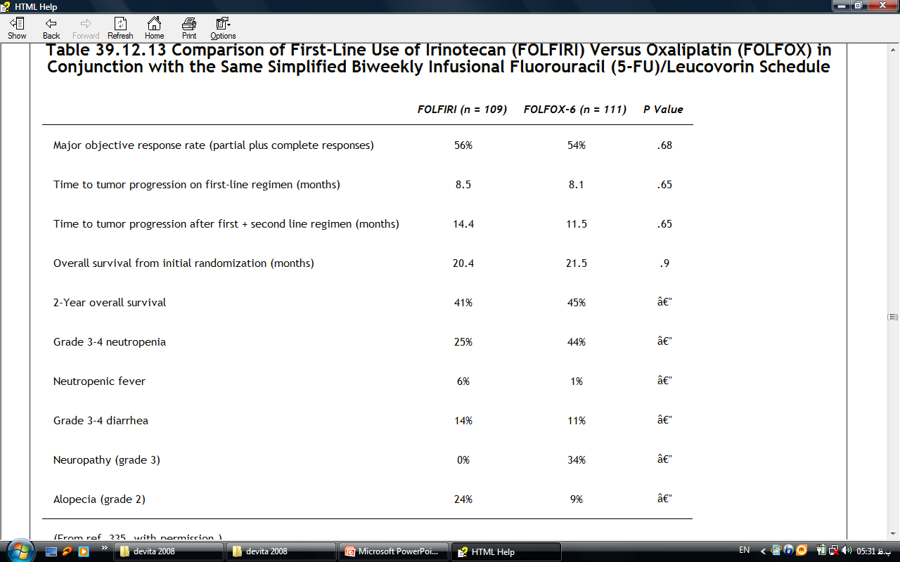

Slide 16
continue chemotherapy until there is either unacceptable toxicity, clinical deterioration, or disease progression.
discontinuation of therapy after a fixed period of time may be a reasonable .
TS, dihydropyrimidine dehydrogenase (DPD), TP,as measured in a tumor specimen by RT-PCR, predict for failure to respond to an infusional 5-FU regimen.

Slide 17
Bevacizumab
humanized monoclonal antibody that binds to VEGF, thus preventing receptor activation.
Hypertension,thromboembolic events and proteinuria
CVA, MI, TIA and angina the risk was essentially linear over time, indicating that the risk of a new arterial thrombotic event was the same in earlier.
GI perforations perforated gastric ulcer, small bowel perforations.

Slide 18
Cetuximab
chimeric monoclonal IgG₁ antibody that recognizes and binds to the extracellular domain of the EGFR.
acnelike rash 75% to 100% of patients treated.
Drying agents and retinoids, such as are used in the treatment of acne, are contraindicated.
hypomagnesemiaThis results from hypermagnesuria

Slide 19
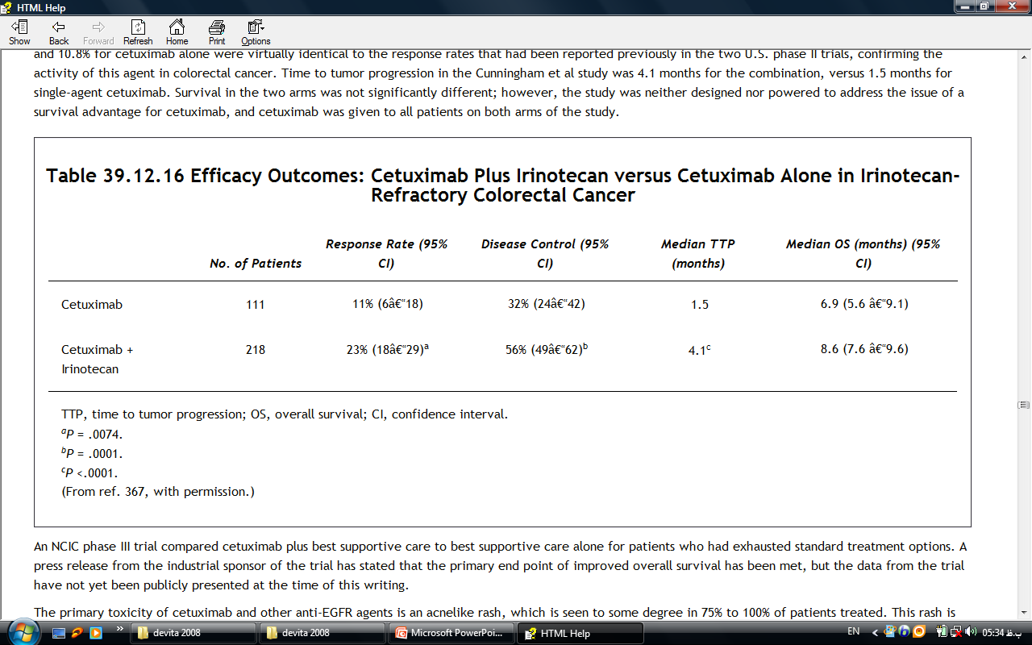

Slide 20
absolutely no correlation between the intensity of the EGFR expression and clinical response.
no patient should be excluded from anti-EGFR therapy simply on the basis of a negative EGFR IHC stain.
Panitumumab (ABX-EGF) is a fully humanized monoclonal antibody that also targets the EGFR

